Slide 1


GAUSSIAN MIXTURE
Team Members:
M. Chandru [927622BAL005]
K. HARISH [927622BAL014]
K.V. LOKESH [927622BAL024]
S.NITHISHKUMAR[927622BAL034]

Slide 2
GAUSSIAN MIXTURE
A Gaussian mixture model is a probabilistic model that assumes all the data points are generated from a mixture of a finite number of Gaussian distributions with unknown parameters.
The Gaussian Mixture object implements the expectation-maximization (EM) algorithm for fitting mixture-of-Gaussian models.

Slide 3
How the GMM algorithm works:
Initialize phase: Gaussian distributions’ parameters should be initialized (means , covariances, and mixing coefficients).
Expectation phase: Determine the likelihood that each data point was created using each of the Gaussian distributions.
Maximization phase: Apply the probabilities found in the expectation step to re-estimate the Gaussian distribution parameters.
Final phase: To achieve convergence of the parameters, repeat steps 2 and 3.

Slide 4
PROPOSED SOLUTION : Gaussian Mixture Models (GMMs) differ from other machine learning models :
Probability-Based Modeling: GMMs are based on the idea that the data is generated from a mixture of several Gaussian distributions. Each Gaussian component represents a cluster or group within the data. This probabilistic approach allows GMMs to model complex data distributions where data points may not neatly fit into distinct clusters.
Soft Clustering: Unlike traditional clustering algorithms like K-means, which assign each data point to a single cluster, GMMs perform soft clustering. This means that each data point is associated with multiple clusters, with varying degrees of membership probabilities. This flexibility can be advantageous when dealing with overlapping clusters or uncertain data points.

Slide 5
Flexible Covariance Structure: GMMs can model different covariance structures, such as diagonal, spherical, or full covariance matrices for each Gaussian component. This flexibility allows them to capture correlations and variances in the data, making them suitable for a wide range of datasets with varying complexities.
Generative Model: GMMs are generative models, meaning they can generate new data points that follow the learned data distribution. This property makes them useful for tasks such as data generation, anomaly detection, and imputation of missing values.

Slide 6
PROJECT CODE
import numpy as np
import pandas as pd
import matplotlib.pyplot as plt
from pandas import DataFrame
from sklearn import datasets
from sklearn.mixture import GaussianMixture
de= pd.read_csv("kk.csv")
x= de.iloc[:, 2:4]
d = pd.DataFrame(x)

Slide 7
plt.scatter(d['Revenue ($B)'],d['Earnings ($B)'])
gmm = GaussianMixture(n_components = 4)
gmm.fit(d)
labels = gmm.predict(d)
d['labels']= labels
d0 = d[d['labels']== 0]
d1 = d[d['labels']== 1]
d2 = d[d['labels']== 2]
d3 = d[d['labels']== 3]

Slide 8
plt.scatter(d0['Revenue ($B)'], d0['Earnings ($B)'], c ='red')
plt.scatter(d1['Revenue ($B)'], d1['Earnings ($B)'], c ='yellow')
plt.scatter(d2['Revenue ($B)'], d2['Earnings ($B)'], c ='green’)
plt.scatter(d3['Revenue ($B)'], d3['Earnings ($B)'], c ='black')
plt.show().

Slide 9
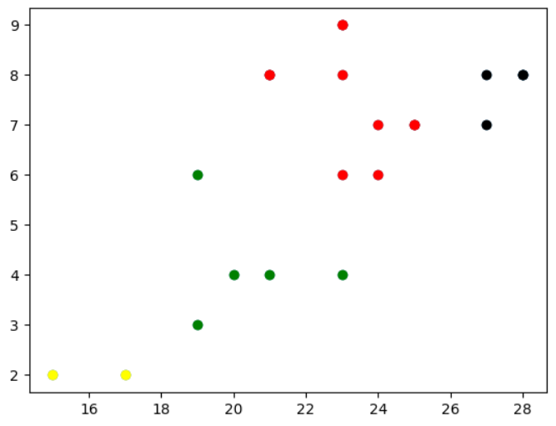
OUTPUT

Slide 10
ADVANTAGES
Flexible in modeling complex data distributions.
Can handle overlapping clusters and uncertainty with soft clustering.
Capable of generative modeling, allowing data generation and anomaly detection.

Slide 11
DISADVANTAGES
Sensitive to parameter initialization.
Computationally intensive, especially with large datasets.
Assumes Gaussian distribution for clusters, which may not always hold true for all data types

Slide 12
APPLICATION
Clustering: GMMs are widely used for clustering tasks where the underlying data distribution is assumed to be a mixture of Gaussian distributions. They can identify clusters with different sizes, shapes, and orientations, making them suitable for complex clustering problems
Anomaly Detection: GMMs can be used for anomaly detection by modeling the normal behavior of a system with Gaussian components. Data points that deviate significantly from the learned distribution are flagged as anomalies, making GMMs effective in detecting unusual patterns or outliers.

Slide 13
Financial Modeling: GMMs are employed in financial modeling for tasks such as risk assessment, portfolio optimization, and fraud detection. They can model the distributions of financial variables and identify unusual patterns or fraudulent activities in financial transactions.
Density Estimation: GMMs can estimate the probability density function of a dataset, allowing for the generation of new data points that closely resemble the original data distribution. This capability is useful in generating synthetic data for simulations or data augmentation.

